Slide 1

TESLA
Overview

Slide 2



Our
TEAM
Ahmed Mahany
Amr Ramadan
Mostafa Eldeeb
Sarah Abu ElGheiit

Slide 3

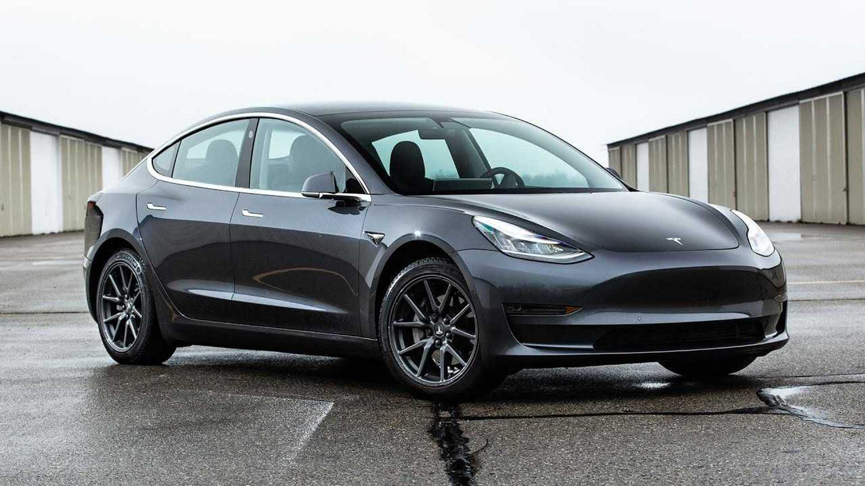
About
Description
As we know that the Number of automobiles Companies increase in short-term time and almost every year there're a big change in number of challengers against Tesla's Automobile segment in making Specific Fuel based Cars with different amazing car designs ,So in this presentation we will be providing an overview of Financial Stocks for Tesla showing it's current situation based on the change of the price of stock and comparing its car sales against other challengers who provide the same car performance and how eligible they are with showing how legal is Tesla Etc. is the company following the governmental political terms in making car license and method recording it?

Slide 4
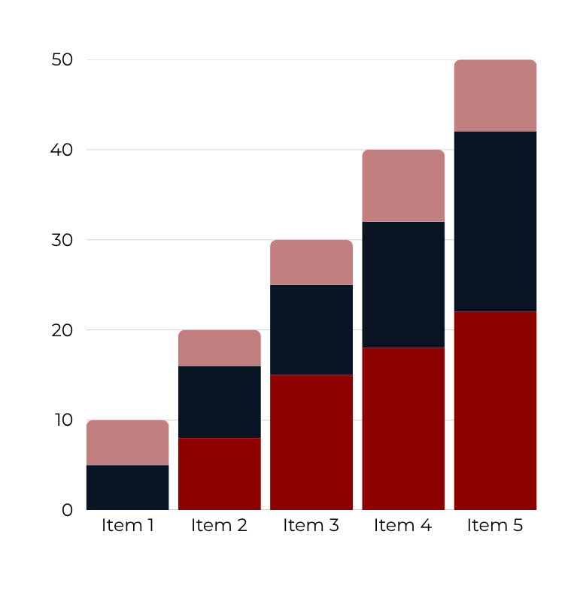
Tesla MARKET ANALYSIS
Tesla is a leader in the EV market, with a brand value of $76 billion in 2023.- The company has delivered nearly 1.8 million vehicles in 2023, reflecting a 38% increase compared to 2022.
And Interest Rates in Long-term interest rates have remained high, with the Federal Reserve's monetary policy playing a crucial role in shaping the market.

Slide 5
Data Source
Investing.com - Stock Market Quotes & Financial News
Dataset – Catalog

Slide 6

Project
KPIs
  Total Vehicles Sold = COUNT(DOL Vehicle ID): Showing Number of cars sold
  Total Sales Value (Revenue) = SUM(Base MSRP) :
  Showing Total sales based on retailer suggestion
  Average Sale Price = AVERAGE(Base MSRP) :
  showing Average Total Sales
  Sales by Model = COUNT(DOL Vehicle ID) GROUP BY Model :
  Showing Number of car Model sold for each Company

Slide 7
OUR KPIs
New vs. Used Vehicle Ratio = COUNT(New Vehicles) ÷ COUNT(Used Vehicles) :
Showing Used Vs New Cars Ratio
Geographical Sales Distribution = COUNT(DOL Vehicle ID) GROUP BY
City/County/State :
Showing the highest Country/state/city with numbers of done sale transactions
CAFV Eligibility Rate = COUNT(Eligible Vehicles) ÷ COUNT(All Vehicles)

Slide 8
OUR KPIs
Sales Trend Over Time = SUM(SALES) GROUP BY Month/Year(Sale Date)
Average Odometer Reading (Used Vehicles) = AVERAGE(Odometer Reading)
WHERE Vehicle = Used
Total Tesla Vehicles Sold = COUNT(DOL Vehicle ID) WHERE Make = "Tesla“
Tesla Market Growth = (Tesla Sales at Period t – Tesla Sales at Period t-1) ÷ Tesla
Sales at Period t-1 × 100

Slide 9
OUR KPIs
Average Tesla Sale Price = AVERAGE(Base MSRP) WHERE Make = "Tesla"
Average Tesla Electric Range = AVERAGE(Electric Range) WHERE Make = "Tesla"
Tesla CAFV Eligibility Rate = COUNT(Eligible Tesla Vehicles) ÷ COUNT(All Tesla
Vehicles)
Tesla Sales Distribution = COUNT(DOL Vehicle ID) GROUP BY (State/City/Legislative
District) WHERE Make = "Tesla"

Slide 10
Stock Market KPI
Stock Price Growth = (Current Price – Previous Price) ÷ Previous Price × 100
Average Stock Price = SUM(Closing Prices) ÷ N
Moving Average (MA) = (Price1 + Price2 + ... + Price) ÷ Number of Days
Daily Returns = (Price at Day t – Price at Day t-1) ÷ Price at Day t-1
Volatility = Standard Deviation(Daily Returns)
Average Trading Volume = Total Trading Volume ÷ Number of Days
Max Drawdown during the selected time = (Peak Price – Trough Price) ÷ Peak Price

Slide 11
Comparison KPIs
Tesla’s sold cars vs other competitors = COUNT(Tesla Vehicles) ÷ COUNT(All EV Vehicles)
Tesla Avg Price vs Competitors = AVERAGE(Base MSRP Tesla) – AVERAGE(Base
MSRP Others)
Tesla Avg Range vs Competitors = AVERAGE(Electric Range Tesla) –
AVERAGE(Electric Range Others)
Tesla CAFV Eligibility vs Others = (Tesla CAFV Rate) – (Other EV CAFV Rate)

Slide 12
THANK YOU

